Slide 1
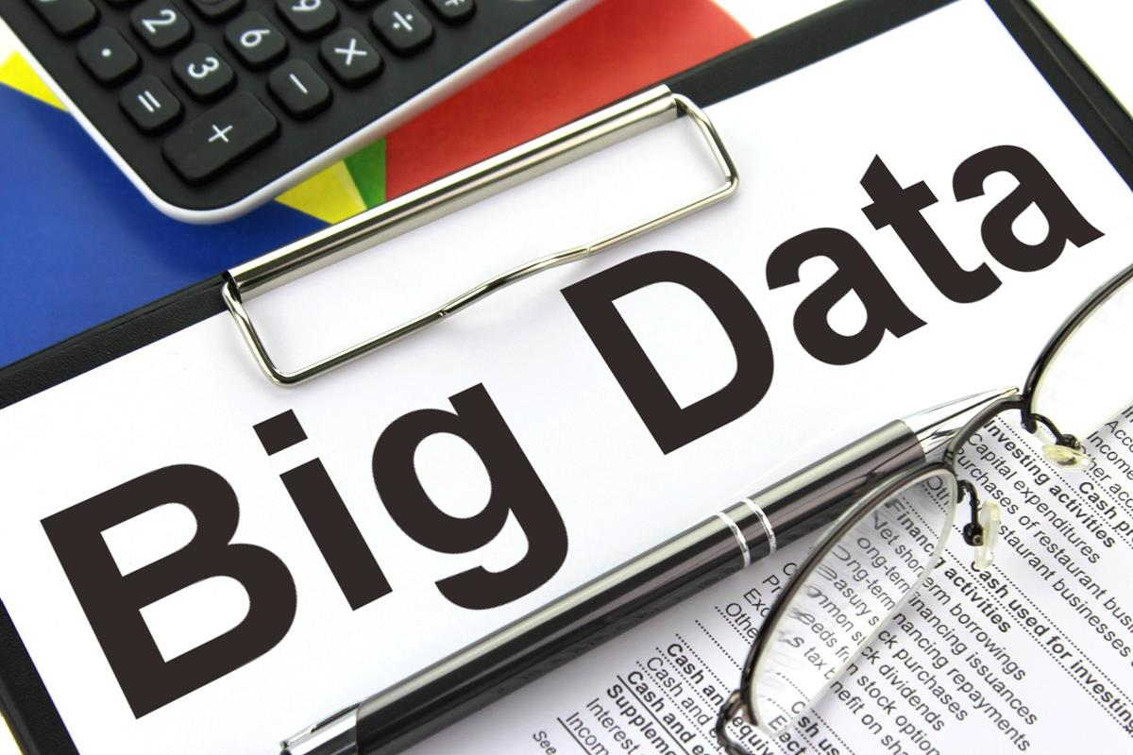
Exploratory analysis of Big Data and Cloud
Introduction to Big Data

Slide 2


What is „Big Data“?!?
Is this really about size?

Slide 3
Naive Definition
Naive definition:
Big data only depends on the data size
1 Gigabyte? 1 Terabyte? 1 Petabyte?
Naive interpretation misses important aspects
Time:
Analyzing 1 Gigabyte of data per day is different from analyzing 1 Gigabyte of data per second
Diversity:
Analyzing spread sheets with numeric data is different from analyzing Web pages that contain a mixture of text and images
Distribution:
Analyzing data from a single source is different from analyzing data from multiple sources

Slide 4


Definition of Big Data
Following Gartner‘s IT Glossary:
Big data is high-volume, high-velocity and/or high-variety information assets that demand cost-effective, innovative forms of information processing that enable enhanced insight, decision making, and process automation.
The three Vs
Volume
Velocity
Variety
Some people actually use 10 Vs to define big data!
Variability
Veracity
Validity
Vulnerability
Volatility
Visualization
Value

Slide 5
The 3 Vs: Volume
Scale of the data must be „big“
No clear definition
Big Data is data that demand innovative forms of information processing“ (Gartner)

Slide 6
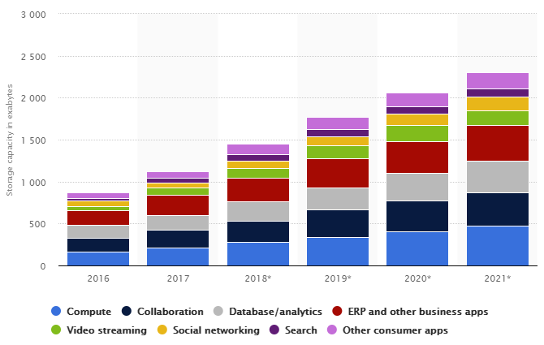
Data center storage worldwide 2016-2021

Slide 7



The 3 Vs: Velocity
Speed at which new data is created
Speed at which data must be processed and analyzed
Often close to real-time

Slide 8
The 3 Vs: Variety
Diversity in data types and data sources
Structured
Semi-Structured
Quasi-Structured
Unstructured
Data with defined types and structure
Example: comma separated values
Textual data with parseable pattern
Example: XML files with schema
Textual data with erratic formats that can be formated with effort
Example: Clickstream data
Data that has no inherent structure, often with multiple formats
Example: Web site, videos

Slide 9
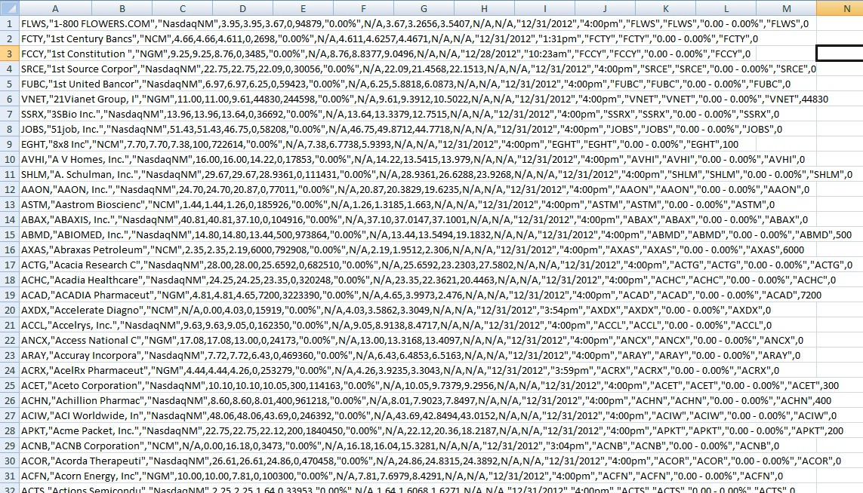
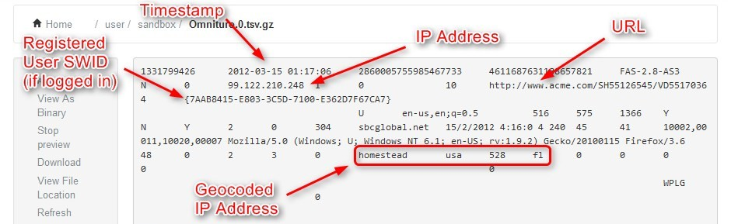
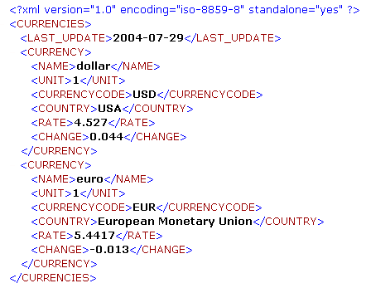
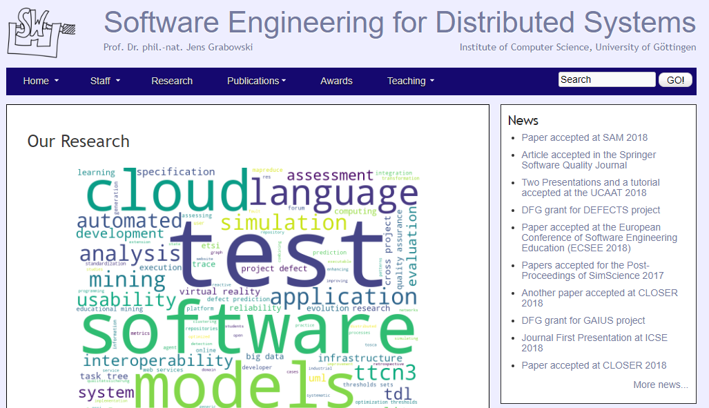
Examples for data types
Structured
Quasi-Structured
Semi-Structured
Unstructured

Slide 10
Structured

Slide 11
Quasi-Structured

Slide 12
Semi-Structured

Slide 13
Unstructured

Slide 14
Big data (most valuable assets)
Data can be a company’s most valuable asset.
Even startups now generate big data!
Using big data to reveal insights can help you understand the areas that affect your business—from market conditions and customer purchasing behaviors to your business processes.

Slide 15
Big data examples
Combining data and information from every stage of an order’s shipment journey with hyperlocal traffic insights to help fleet operators optimize last-mile delivery
Using image data from cameras and sensors, as well as GPS data, to detect potholes and improve road maintenance in cities
Using AI-powered technologies like natural language processing to analyze unstructured medical data (such as research reports, clinical notes, and lab results) to gain new insights for improved treatment development and enhanced patient care

Slide 16


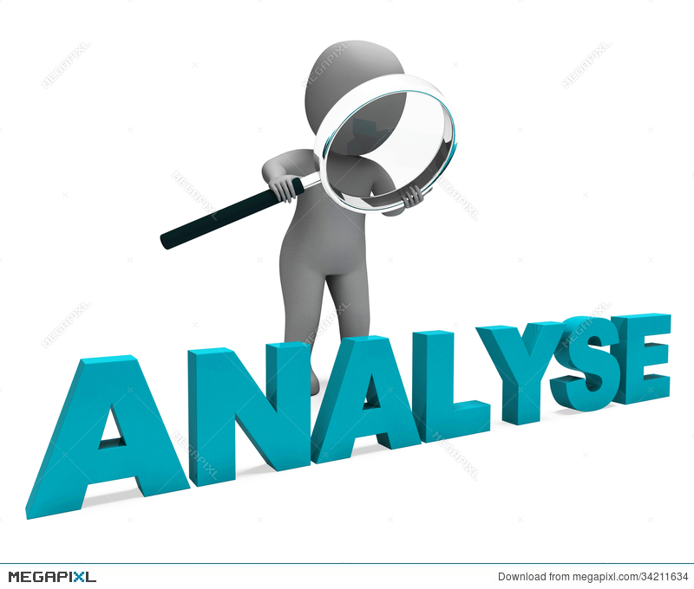

How does big data work?
Integrate
Manage
Analyze

Slide 17
How does big data work?
Integration: Big data collects terabytes, and sometimes even petabytes, of raw data from many sources that must be received, processed, and transformed into the format that business users and analysts need to start analyzing it.
Management: Big data needs big storage, whether in the cloud, on-premises, or both.
Analysis:
Analyzing and acting on big data
Communicate and share insights across the business in a way that everyone can understand.

Slide 18
Big data benefits
Improved decision-making
Big data is the key element to becoming a data-driven organization.
More efficient operations
generate insights that can help you determine areas where you can reduce costs, save time, and increase your overall efficiency.
Improved risk management
Analyzing vast amounts of data helps companies evaluate risk better—making it easier to identify and monitor all potential threats and report insights that lead to more robust control and mitigation strategies.

Slide 19
Some challenges of implementing big data analytics
Lack of data talent and skills
Data scientists, data analysts, and data engineers are in short supply—and are some of the most highly sought after (and highly paid) professionals in the IT industry.
Lack of big data skills and experience with advanced data tools is one of the primary barriers to realizing value from big data environments.
Problems with data quality
Data quality directly impacts the quality of decision-making, data analytics, and planning strategies.
Raw data is messy and can be difficult to curate.

Slide 20
Some challenges of implementing big data analytics
Compliance violations
Big data contains a lot of sensitive data and information, making it a tricky task to continuously ensure data processing and storage meet data privacy and regulatory requirements, such as data localization and data residency laws.
Integration complexity
Most companies work with data siloed across various systems and applications across the organization.
Security concerns
Big data contains valuable business and customer information, making big data stores high-value targets for attackers.
Since these datasets are varied and complex, it can be harder to implement comprehensive strategies and policies to protect them.

Slide 21
Data Lakes and Data warehouses
A data lake is a centralized repository that allows you to store all your structured, semi-structured, and unstructured data at any scale. Data is stored in its raw format until it is needed.
A data warehouse is a centralized repository that stores structured data from multiple sources. It is designed for query and analysis, supporting business intelligence and reporting.

Slide 22
Data Management
Data Management is the comprehensive process of collecting, storing, organizing, securing, and maintaining data to ensure its accuracy, accessibility, and reliability.
Key Components:
Data Governance (policies and compliance)
Data Quality Management
Data Security and Privacy
Master Data Management (MDM)
Master Data Management (MDM) is a strategy and set of processes used to create a single, consistent, and authoritative source of truth for core business data across an organization.
Data Lifecycle Management
Purpose: To ensure data is accurate, secure, and available for analysis and decision-making.
Example: A hospital’s data management system handles patient records, ensuring compliance with data privacy regulations (like GDPR or HIPAA).

Slide 23
Key Components of Data Management
Data Collection
Data Storage
Data Integration
Data Processing
Data Governance
Data Security
Data Quality Management
Data Analytics & Visualization
Master Data Management (MDM)
Data Lifecycle Management

Slide 24
Key Components of Data Management
Data Collection
Gathering data from various sources, such as IoT devices, databases, APIs, and user inputs.
Example: Sensors in smart cities collect traffic, weather, and pollution data.
Data Storage
Storing data in databases, data warehouses, data lakes, or cloud environments.
Technologies: SQL/NoSQL databases, Amazon S3, Hadoop, etc.
Data Integration
Combining data from multiple sources to provide a unified view.
Tools: ETL (Extract, Transform, Load) processes, APIs, data pipelines.

Slide 25
Key Components of Data Management
Data Processing
Transforming raw data into meaningful information through cleaning, filtering, and aggregating.
Example: Normalizing financial data for cross-departmental reporting.
Data Governance
Defining policies, standards, and procedures to ensure data quality, privacy, and compliance.
Key Aspects: Data stewardship (as orgnaization asset), metadata management, and regulatory compliance (e.g., GDPR).
Data Security
Protecting data from unauthorized access, breaches, and loss.
Techniques: Encryption, access controls, backup strategies.

Slide 26
Key Components of Data Management
Data Quality Management
Ensuring data is accurate, consistent, complete, and timely.
Example: Removing duplicate customer records in a CRM system.
Data Analytics & Visualization
Analyzing data to extract insights and support decision-making.
Tools: Power BI, Tableau, Python (Pandas, Matplotlib), R.
Master Data Management (MDM)
Creating a single, consistent view of critical business data, such as customer or product information.
Data Lifecycle Management
Managing data from creation and storage to archival and deletion.

Slide 27
Importance of Data Management
Improved Decision-Making: High-quality data leads to better insights and strategic decisions.
Operational Efficiency: Automating data workflows reduces manual effort.
Regulatory Compliance: Ensures adherence to data protection laws.
Risk Mitigation: Protects against data breaches and financial losses.

Slide 28
Modern Data Management Approaches
Cloud Data Management: Storing and processing data in cloud environments for scalability.
Data Lakes vs. Data Warehouses: Data lakes handle large volumes of raw data, while warehouses are optimized for analytics.
Real-Time Data Processing: Technologies like Apache Kafka enable immediate analysis of streaming data.

Slide 29
🛠 Data Engineering
Data Engineering focuses on designing, building, and maintaining the infrastructure (pipelines, databases, systems) that enables the collection, storage, and analysis of data.
Key Responsibilities:
Building ETL (Extract, Transform, Load) pipelines
Data Integration from multiple sources
Optimizing data storage solutions
Enabling real-time data processing

Slide 30
Example ETL
Copy data from source to sink and apply some processing on the way
ETL
Extract data from source (SQL database, csv file, API, ...etc).
Transform the data by cleaning and processing it.
remove missing values
drop irrevelant columns
parse data
parse numeric columns
....
Load the cleaned data into a database.

Slide 31
🛠 Data Engineering
Key Tools & Technologies:
SQL, Python, Scala
Apache Spark, Airflow, Kafka
Data Warehousing (Snowflake, Redshift)
Cloud Data Services
Purpose: To create the technical foundation that allows data scientists and analysts to work efficiently.
Example: A data engineer builds a pipeline that collects user interaction data from a mobile app, processes it in real time, and stores it in a data warehouse for analysis.

Slide 32
Data Spaces
Federated, decentralized, and interoperable data ecosystems where different organizations, institutions, or systems can securely share and exchange data while maintaining sovereignty over their data.
Key Aspects of Data Spaces
Data Sovereignty – Organizations retain control over their data, deciding how and by whom it can be used.
Interoperability – Data from different sources can be integrated and used seamlessly.
Decentralization – Unlike traditional data warehouses or lakes, data spaces do not require a central repository; instead, data remains distributed across different participants.
Standardization & Governance – Common standards and governance models ensure data quality, security, and compliance with regulations (e.g., GDPR, Data Act).
Trust & Security – Secure data-sharing mechanisms, including identity management, encryption, and access controls, ensure privacy and protection.

Slide 33
Examples of Data Spaces
GAIA-X (Europe): A framework for federated data infrastructure in various industries.
International Data Spaces (IDS): A reference architecture for secure and sovereign data exchange.
Healthcare Data Spaces: Secure sharing of patient data while complying with health regulations.
Financial Data Spaces: Open banking ecosystems where financial institutions share transaction data securely.

Slide 34
Data Spaces & Big data
The transition from traditional centralized big data architectures to decentralized, secure, and collaborative models.
The role of federated learning in privacy-preserving analytics.
Real-world case studies of data spaces in sectors like healthcare, finance, and smart cities.
Technologies enabling data spaces, such as APIs, cloud computing, blockchain, and AI-driven data governance.

Slide 35
How Big data , Data Managment and Data Engineering Work Together
Data Engineering builds the pipelines and infrastructure.
Big Data refers to the large, complex datasets processed using that infrastructure.
Data Management ensures the data is accurate, secure, and governed properly throughout its lifecycle.

Slide 36
Comparison
Aspect | Data Management | Big Data | Data Engineering
Focus | Data quality, governance, security | Handling large-scale, complex data | Building data pipelines and infrastructure
Key Concern | Data accuracy, availability, compliance | Volume, velocity, variety of data | Data flow, storage, processing efficiency
Tools/Technologies | Data Governance tools, SQL databases | Hadoop, Spark, NoSQL, Streaming tools | ETL tools, Airflow, Spark, Cloud services
Who Uses It | Data Stewards, Data Managers | Data Analysts, Data Scientists | Data Engineers, Software Developers

Slide 37

Questions

